Slide 1

We Deliver Better Solutions !
$
Notes:
Thank you for your time and opportunity that provided to Nobel solutions today to make a presentation and discuss with you
Our first agenda today is to present you the company profile and overall all of our EZY-HR then out Technical support manager will guide you through the demo.
We can further discuss in details or solutions after presentation or demo as our vision ‘we deliver better solutions’

Slide 2

Work Anywhere
From
Any Device
Collaborate
Anytime
OUR VISION
Cloud Technology
Supporting multiple businesses or branches
Manage your businesses from anywhere
Online from your iPad, iPhone, Android device
Notes:
Our vision is to support your business and management team are ‘Work from anywhere’ , ‘From any device’, and ‘Collaborate anytime’
You will get the real time information and able to make a right decision immediately

Slide 3



Solutions by …

Slide 4
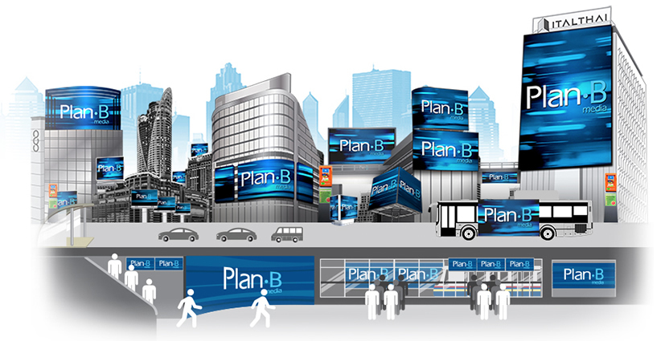
Solutions by …

Slide 5

Solutions by …

Slide 6
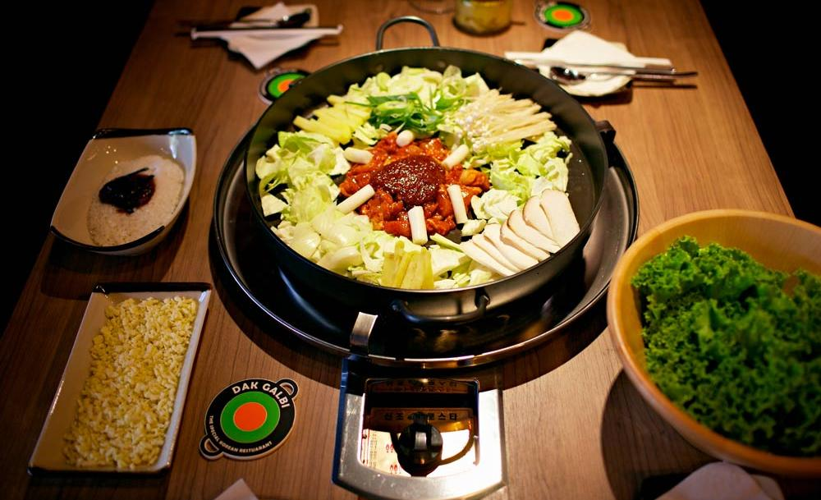
Solutions by …

Slide 7


Solutions by …

Slide 8


Solutions by …

Slide 9
















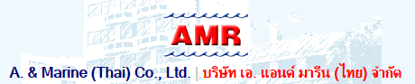
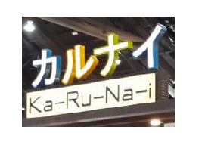

Slide 10




Freewill Solutions Company Limited.
29 th Floor, Lumpini Tower 1168/86-88 Rama IV Road Tungmahamek Sathorn Bangkok 10120 Thailand
Our Partner …

Slide 11
01
PAYROLL
02
LEAVE ONLINE
03
OT MANAGEMENT
04
TIME STAMP (FINGER PRINT SCANNER)
05
EMPLOYEE DATABASE
06
HR DOCUMENTS
Notes:
EZY-HR consists of 6 main functions
Payroll
Leave online
OT management
Time stamp
Employee database
HR documents

Slide 12
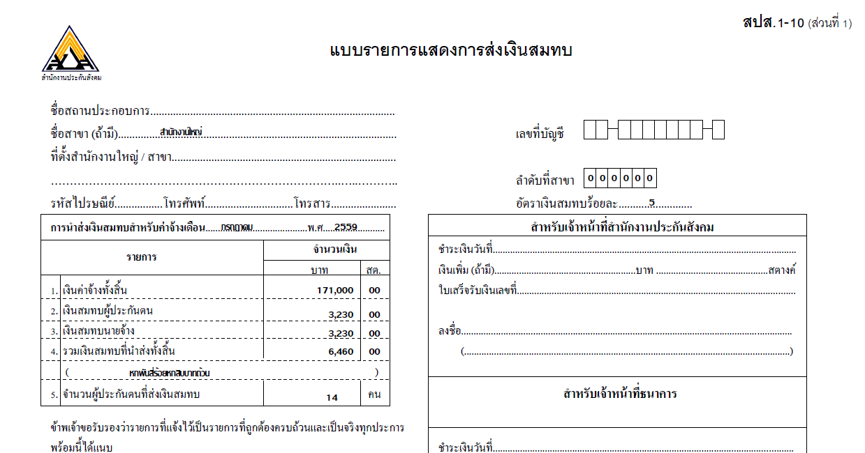
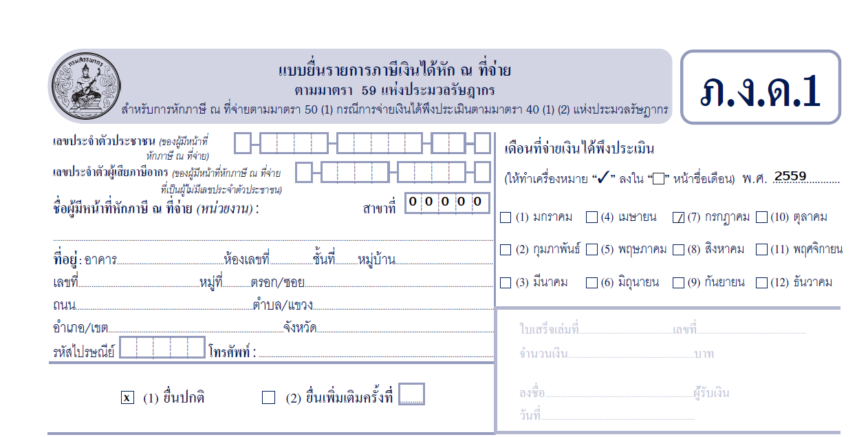
Automatic upgrade New features and HR forms

Slide 13
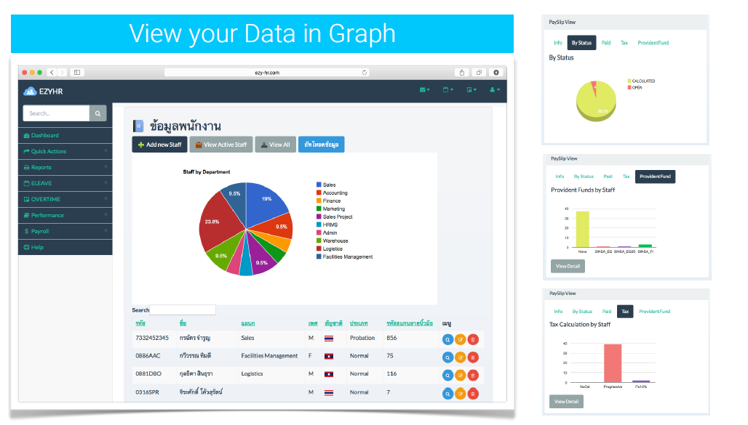
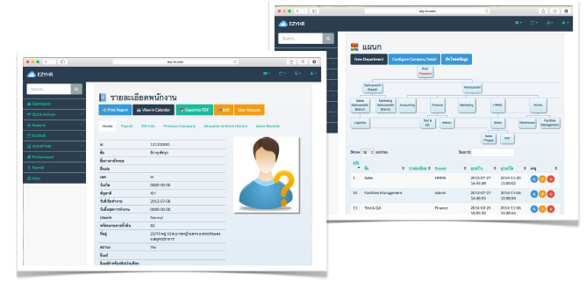
User Friendly Interface Design
And
Dashboard
Notes:
EZY-HR using flat designs as you can see the modern web based application here. It’s convenience and easy to use.

Slide 14
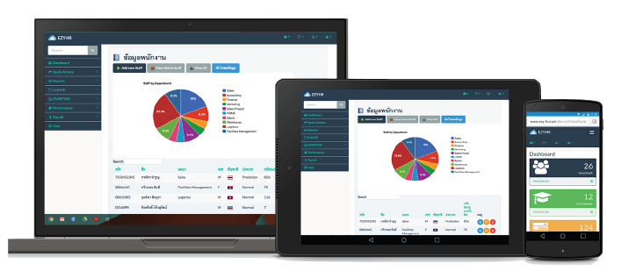
New Way of Working
Access EZY-HR from Mac, PC, iPad, iPhone, Android
Notes:
As from our focus, Work anywhere, From any device, and collaborate any time.
EZY-HR and all nobel solutions’s system is the choice for your business that able to access from web browser and make real time information flow to you

Slide 15

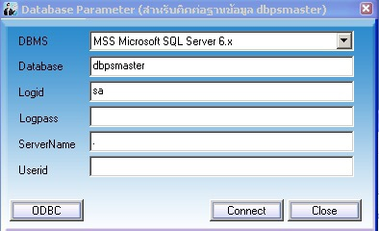

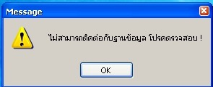
No Server at your office
No program to be installed in your computer

Slide 16
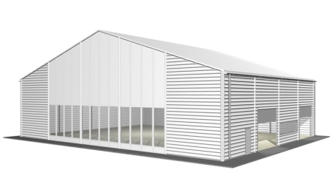




ONLINE
Multiple Offices
Many Branches
Managed by HR Head Office

Slide 17
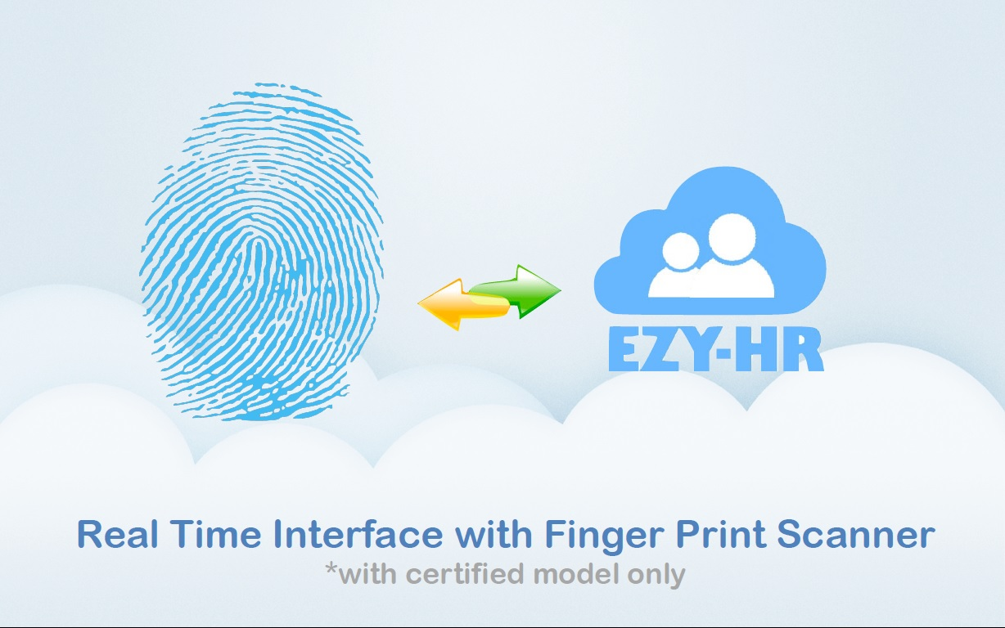

Slide 18
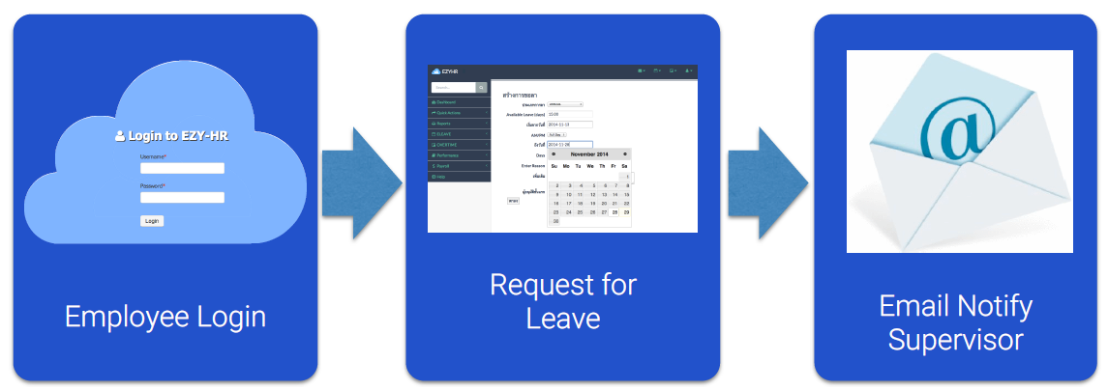
Employee Self Service
Employee can access the system, and request for Leave, OT, Documents
Notes:
To optimize the time of HR staff, EZY-HR designs to support employee self service way of working.
They will have their own user and password to manage their request and track their status.

Slide 19

Secure your data on the Cloud
Main Production Server is located in Bangkok Data Center
Automatically Nightly backup to Disaster Recovery Site
Disaster Recovery Server is based on Singapore
Notes:
With the highest security in cloud technology. Our server is located at CAT telecom which you can make sure the highest security we provided.
Also we have automatic back up every night and we also we have back up server located in Singapore

Slide 20
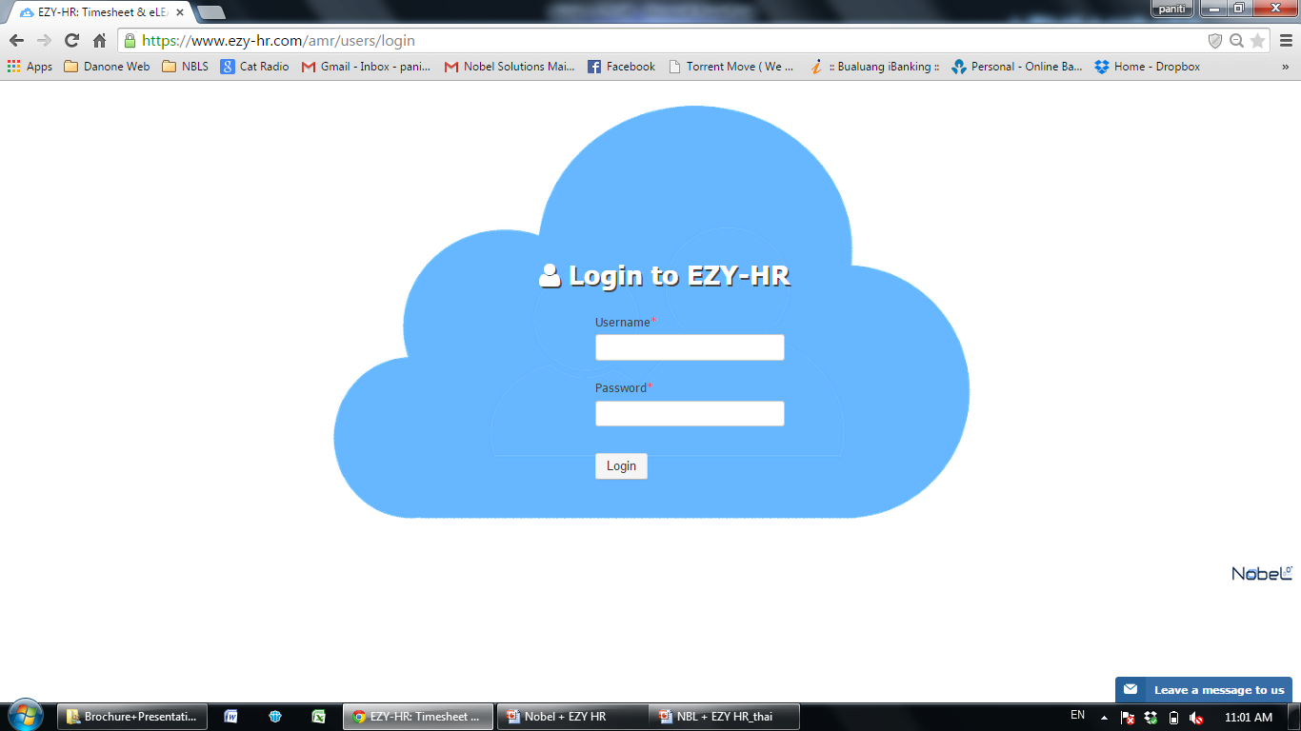
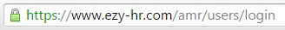
Password Encrypt
Notes:
We can assure you the highest security by encrypted web traffic and encrypted password

Slide 21
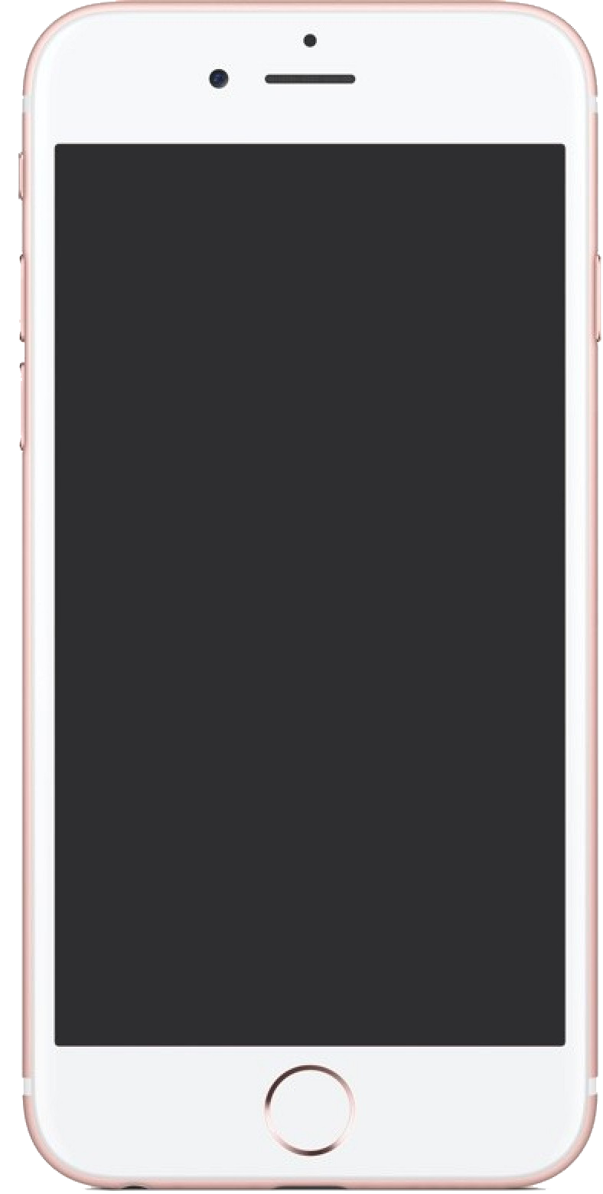
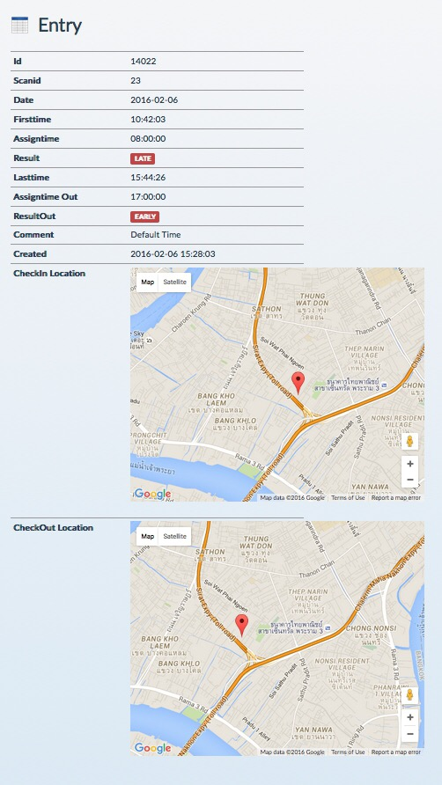
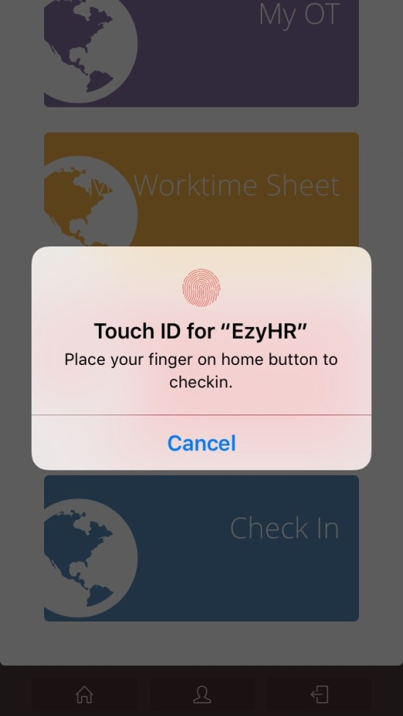
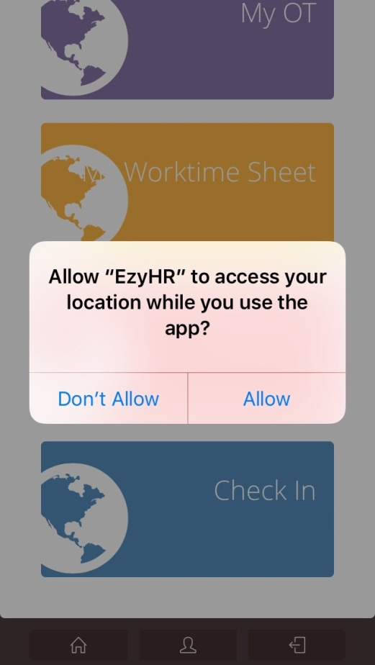
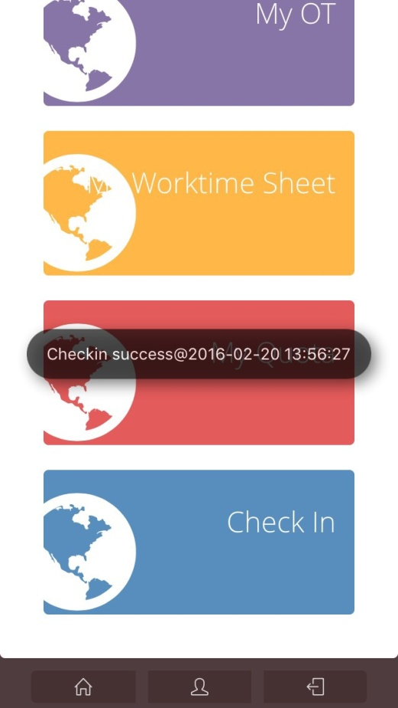
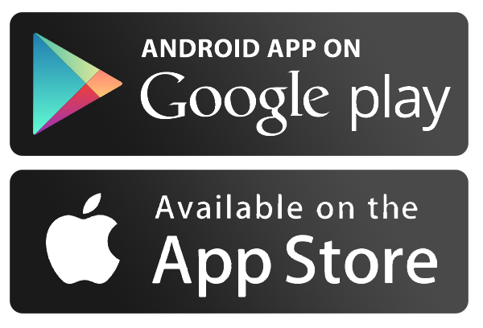
Mobile Application

Slide 22



EZY- Expense
Notes:
All product of Nobel solutions is cloud based system with the latest technology, we can guarantee the highest security also the easiest to use and further development. You can online from anywhere with any device
Currently, we have main 4 product lines which are
EZY-Fleet: the system to manage fleet, trucks for example we can know the utilization of truck, fuel efficiency of each truck, driver history, also maintenance history of each truck
EZY-HR: the system that easy to use and cover all activity of HR
VIEW Xpress: is the cost management and POS system. We can know real time status of our business
Check stock pro: the inventory management system that apply from warehouse management system to suit the business that need to track the inventory. System can link and online from many warehouse with barcode system tracking

Slide 23
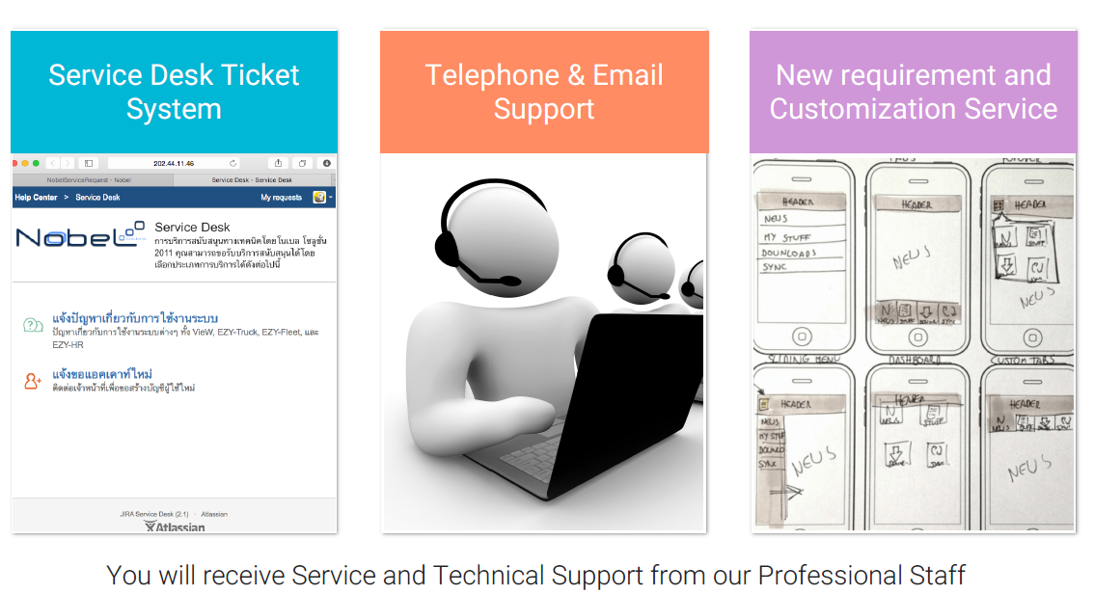
Service & Support
Notes:
Nobel solutions will provided you the best after sale service
We have service desk ticket system called JIRA system that you can login and leave any issue to us
Telephone and mail support
We have consultant team to help you for any new requirement to suit your business

Slide 24

Add-Ons
Travel Request
Duty Roster
Many Add-Ons
Performance (KPI)
Management
Mobile
Notification
and more to come….
Notes:
As our solutions, we are willing to provide you the better solutions. Many add-ons that we can develop further for your business

Slide 25
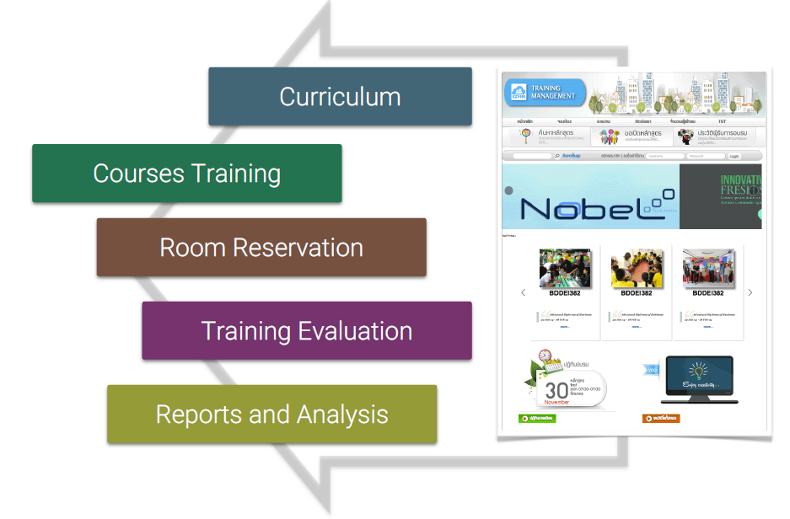
EZY-TRAINING : Training Management
Notes:
EZY-HR training is another module to manage your people regarding training. The system can show all curriculum and staff can request for training and get approval.

Slide 26

We Deliver Better Solutions !

